Slide 1
Visualisation of Road Traffic Accidents In the UK
MSc data science Dissertation
Leeds beckett university
Student: May Tharaphi Zaw
Supervisor: Patrick Ingham

Slide 2
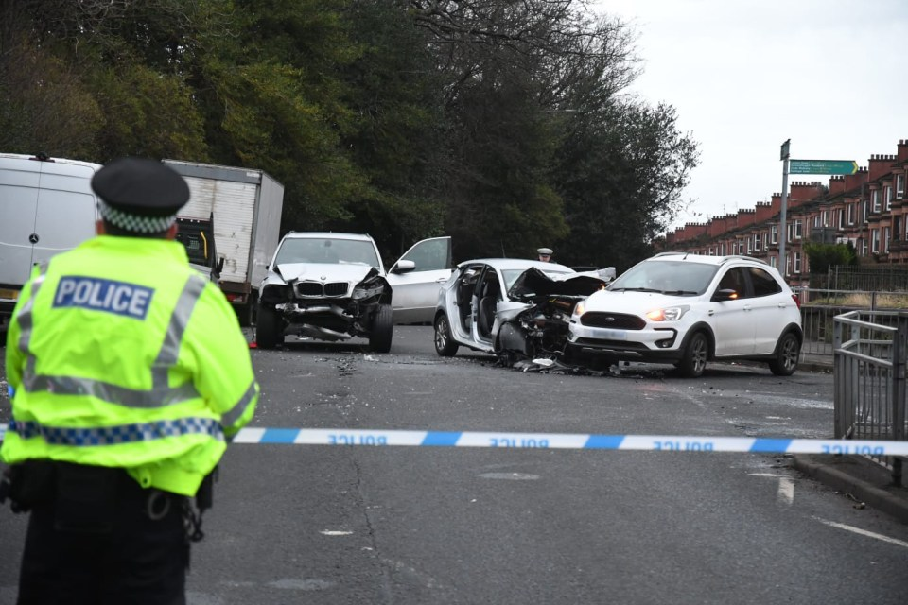
UK RTAs
Total deaths: 1,695 people in 2023
Total serious injuries: 28,967 people across UK
Total casualties: 140,962 total casualties of all severities reported in the UK.
Image Reference: The Scottish Sun

Slide 3
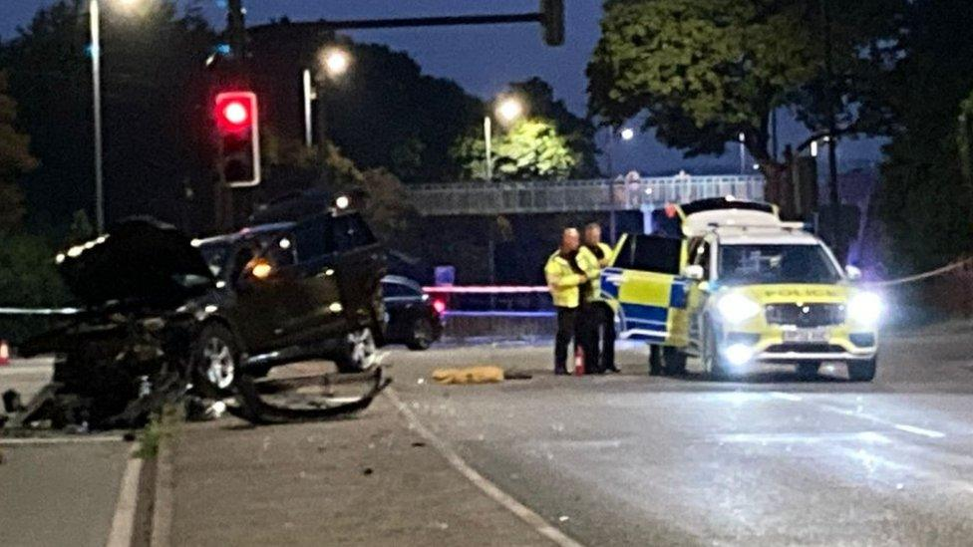
Context
RTAs: global & UK public health concern
Leeds risks: weather, urban roads, special events/festivals/sports matches
Aim: Analyse & visualise accidents > interactive dashboards
Image Reference: BBC News

Slide 4
Research Questions
Do special events influence accident frequency and risk in Leeds, particularly around major hotspots?
How do weather conditions, including sunlight and rainfall, shape accident frequency and severity across Leeds?
What are the temporal patterns of road traffic accidents, and how does severity vary across these periods?
Which demographic groups and road users are most at risk in Leeds roads?
Do vehicle types and key urban features play a significant role in accident risk across Leeds?
How can data visualisation tools help translate these findings into actionable insights for policymakers and transport authorities?

Slide 5
Data Sources
STATS19: collisions, casualties, vehicles (2019-2023) (link)
Open-Meteo API: rainfall, sunshine duration (link)
Leeds United fixtures: home matches (link)

Slide 6
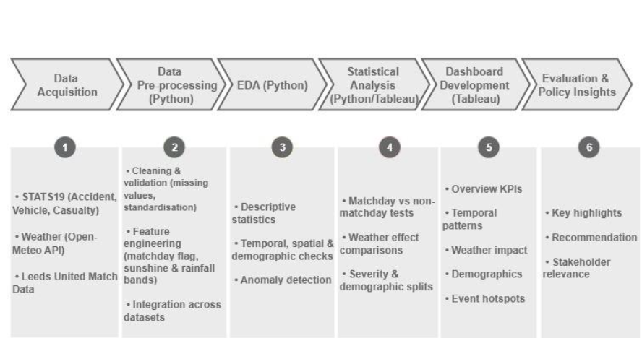
System Implementation Framework

Slide 7
Methods & Workflow
Python: data preprocessing and cleaning
Tableau: dashboard implementation & visualisation
Hybrid workflow ensures rigour + accessibility

Slide 8
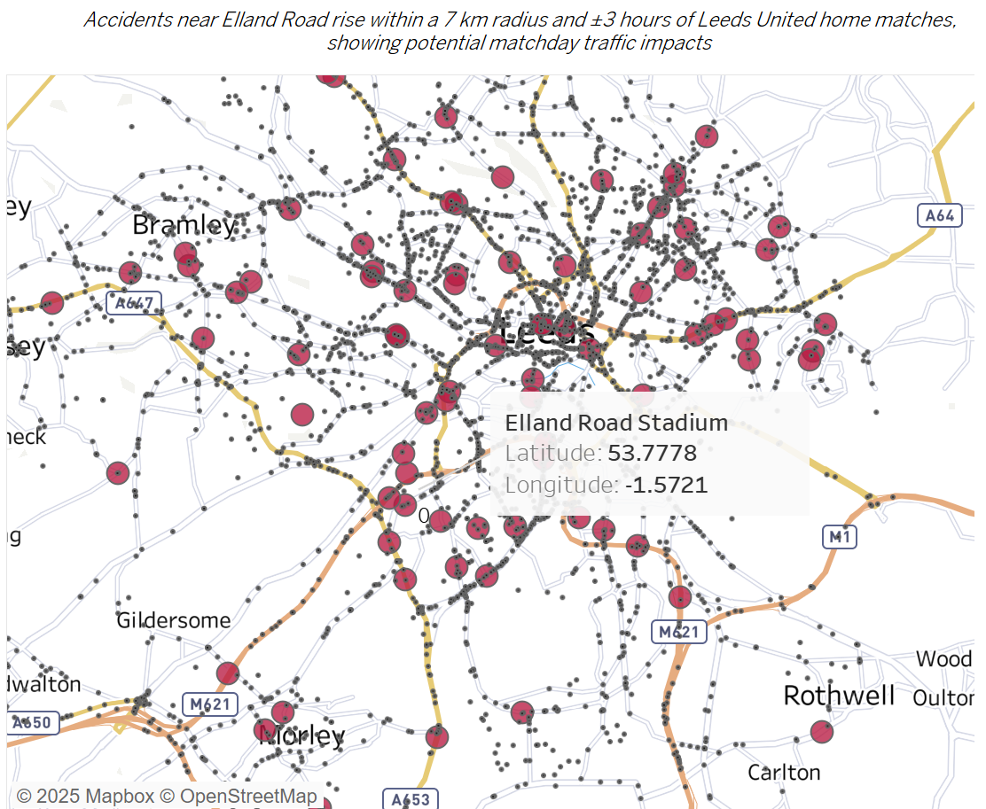
Key Findings: Events
Accidents increased conditionally on Leeds United matchday, particularly on Fridays
7 km radius around Elland Road > away-fan traffic & congestion
Event-specific traffic management needed

Slide 9
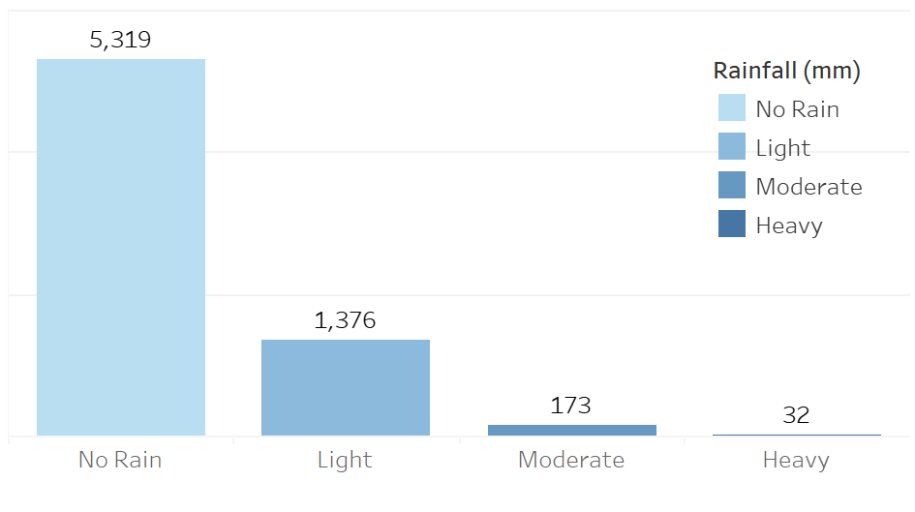
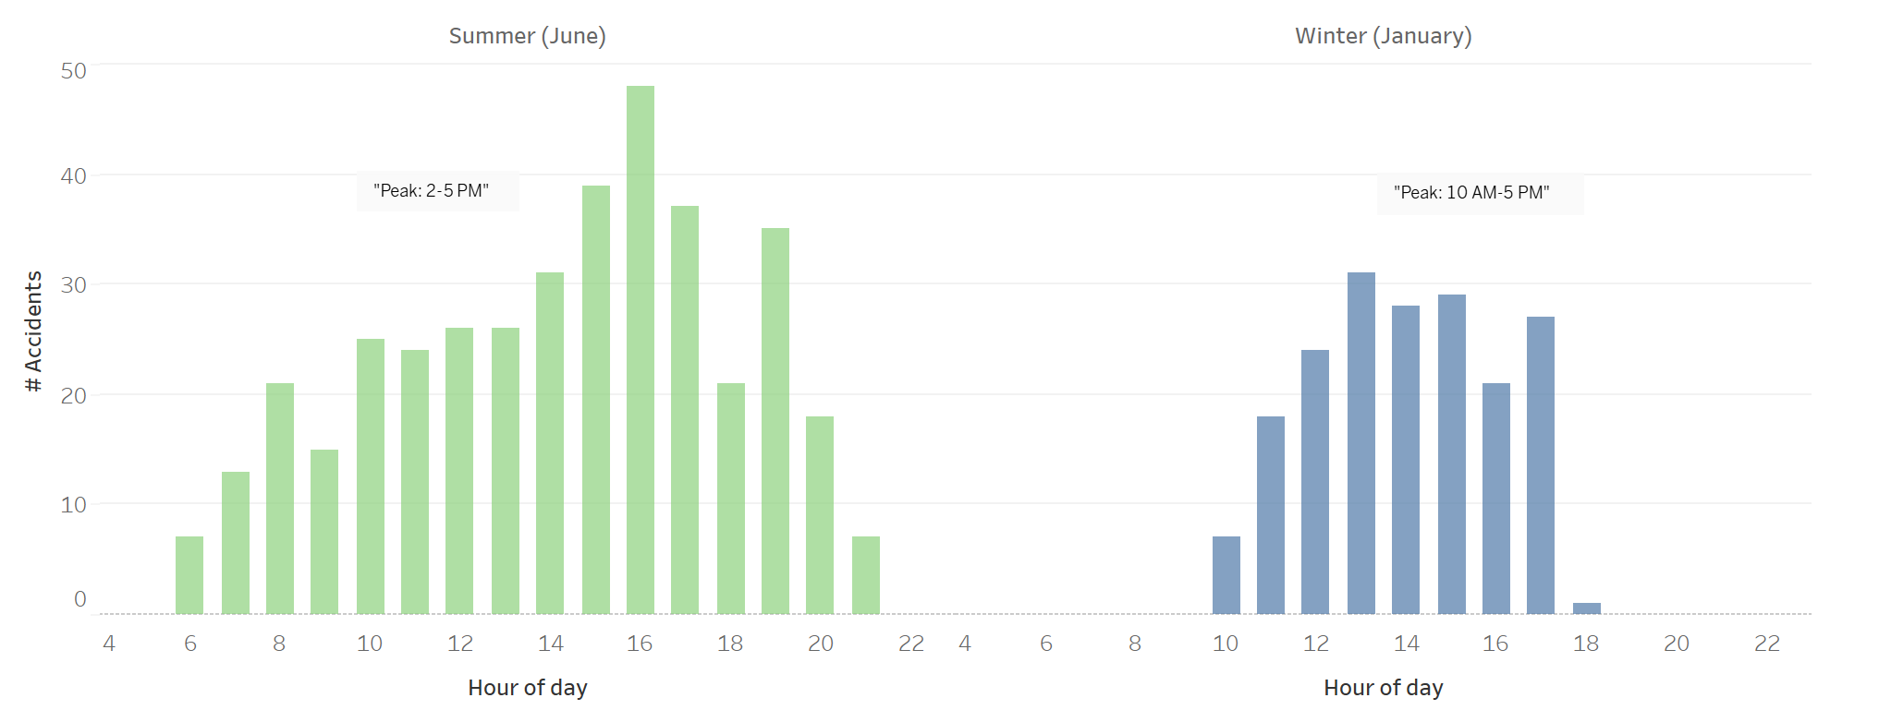
Key Findings: Weather
Light rain & glare underestimated hazards
Heavy rain saw fewer accidents (cautious driving)
Sun glare increased summer accident risks

Slide 10
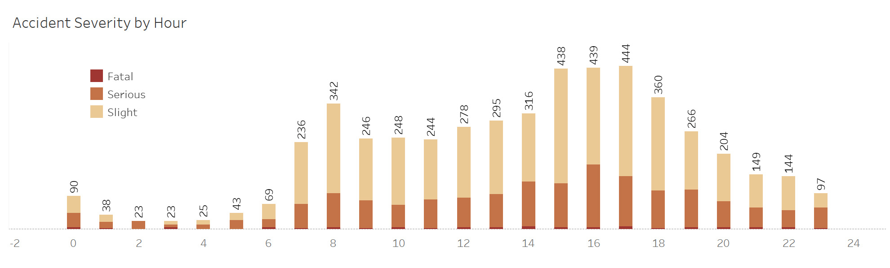
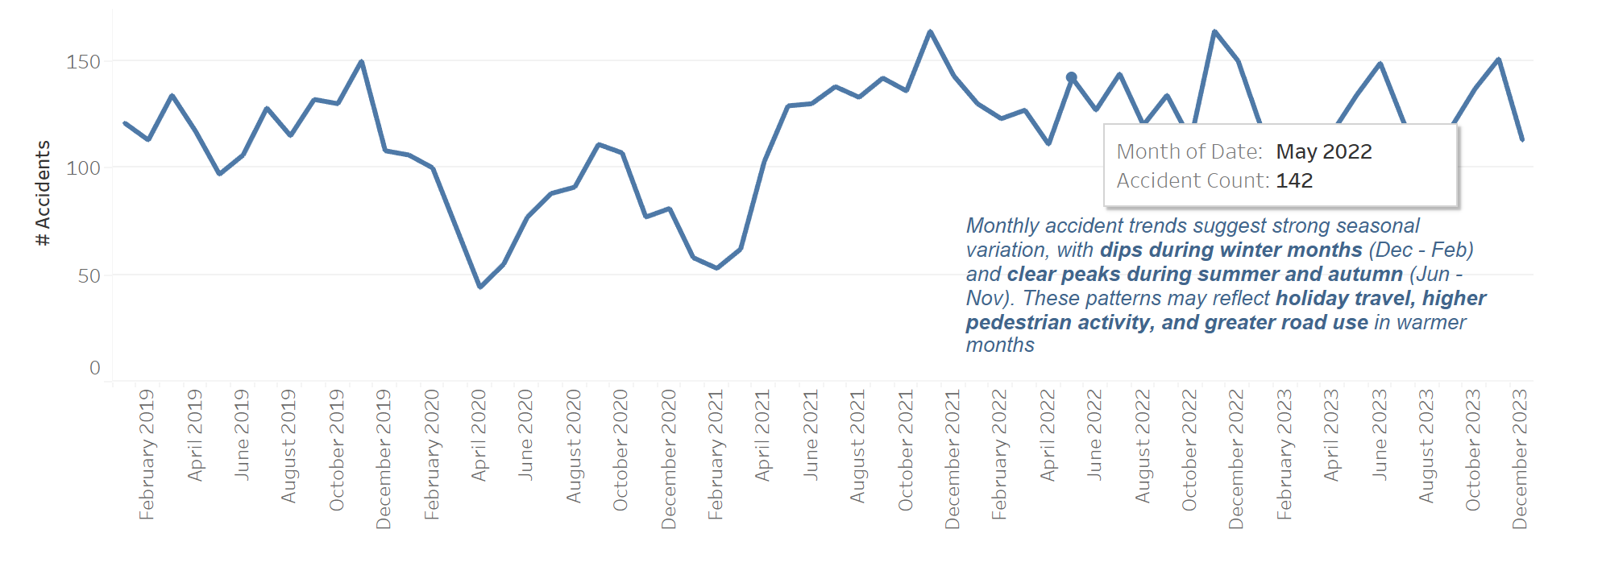
Key Findings: Temporal Patterns
Rush-hour peaks: 8-9 AM & 4-6 PM
Fridays consistently higher risk
COVID lockdown > sharp but temporary drop

Slide 11
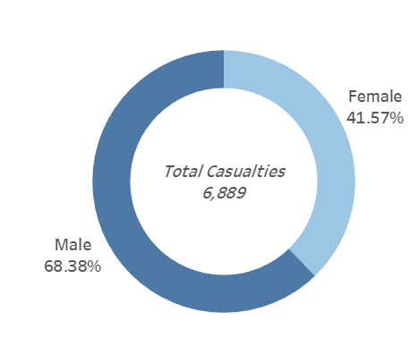
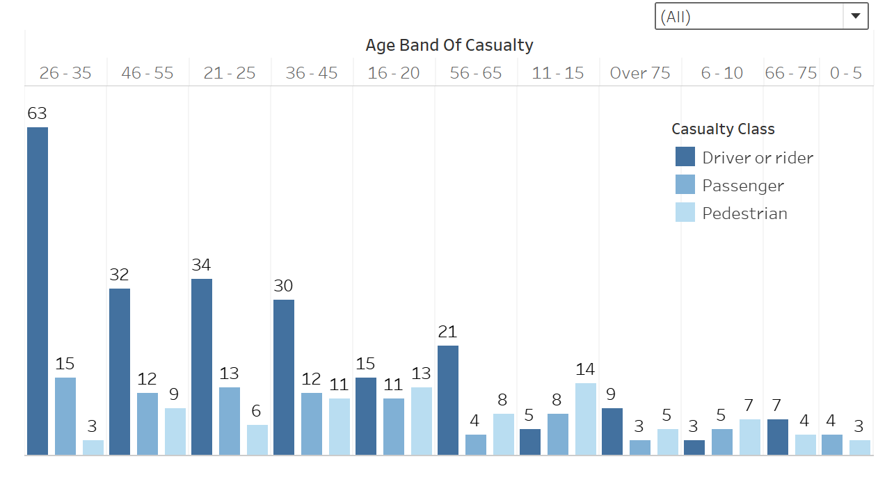
Key Findings: Demographics
Young male drivers overrepresented
Pedestrians 11-15 most vulnerable
Cyclists (esp. commuters & delivery riders) at risk

Slide 12
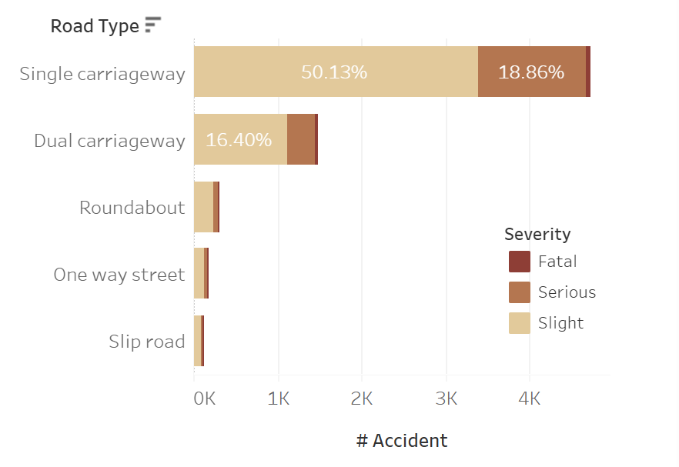
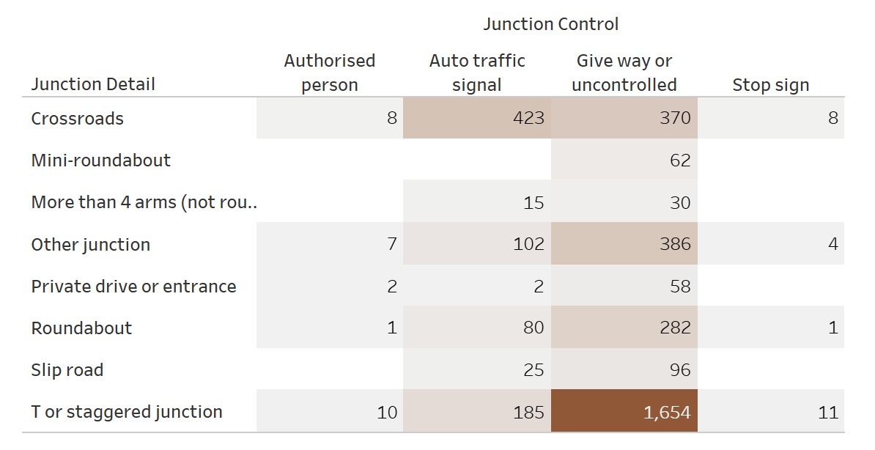
Key Findings: Infrastructure
Single carriageways = majority of accidents
Uncontrolled junctions > hotspots
Signalised crossroads also had high accident counts

Slide 13
Dashboard Demonstration
Overview dashboard: hotspots & trends, temporal patterns
Event dashboard: matchday vs non-matchday, hotspot area
Weather dashboard: rainfall & sunlight risks
Demographics dashboard: age & gender splits, high-risked casualty groups
Infrastructure dashboard: analysis on types of roads, vehicles, and junctions
Go to: Tableau Public Dashboard Website

Slide 14
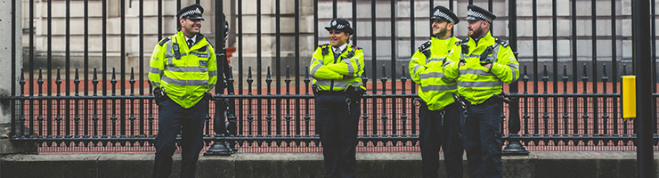
Policy & Practice Implications
Event management: police control, parking, away-fan guidance
Weather: campaigns for light rain & glare risks
Temporal: rush-hour enforcement, school safety
Demographics: cycling infrastructure, child pedestrian safety
Infrastructure: redesign junctions & single carriageways
Image Reference: DBS Check

Slide 15
Limitation & Future Work
No traffic volume data (exposure issue)
Event dataset limited to football matches only
Future: expand events, add exposure data, ML models, replicate in other UK cities

Slide 16
Conclusion
Accident risks shaped by weather, time, demographics, infra, events
Dashboards bridge raw data > actionable insights
Methodology replicable in other cities

Slide 17
Final Key Takeaways & Recommendations
Key Findings | Recommendations
Events: Friday Leeds United matchdays showed higher accident risk within 7 km of Elland Road | Event Planning: Stronger police control, parking, and away-fan navigation.
Weather: Light rain and glare posed bigger risks than heavy rain. | Weather Campaigns: Public awareness of light rain/glare, anti-glare screens and improved markings.
Demographics & Infrastructure: Young male drivers, cyclists, and 11-15 pedestrians were most vulnerable. Single carriageways and uncontrolled junctions were hotspots. | Targeted Safety: Cycling infrastructure, school crossing patrols, and redesign of high-risk junctions.

Slide 18
Project Package
Github Repository
https://github.com/maytharaphizaw/leeds-uk-rta-visual-analytics-2019-2023
Tableau Public:
https://public.tableau.com/app/profile/may.tharaphi.zaw4774/viz/shared/Y5MRHJ7C4

Slide 19
Thank You
Any questions?
m.zaw3483@student.leedsbeckett.ac.uk

